Slide 1

Robust, Scalable, Real-Time Event
Time Series Aggregation at Twitter
Peilin Yang, Srikanth Thiagarajan, Jimmy Lin
Data Infrastructure Engineering Team
september 2014

Slide 2
#Outline
The Challenges
How do we tackle the challenges?
Case Study: Tweets Engagement
Takeaways

Slide 3
The Challenges

Slide 4
#Scale
~500 Million Tweets/day
~350 Billion Events/day
~5,000 Tweets/second
~4 Million Events/second
George Lee, Jimmy Lin, Chuang Liu, Andrew Lorek, and Dmitriy Ryaboy. The Unified Logging Infrastructure for Data Analytics at Twitter. Proceedings of the VLDB Endowment, 5(12):1771-1780, 2012.

Slide 5
#Real-time Processing
Public Safety
Data Analyst
ML/DL Model
Search Indexing
Tweets Engagement

Slide 6
#Real-time Processing
Public Safety
Processing
Layer?
Data Analyst
ML/DL Model
Search Index
Engagement Counter

Slide 7
#Real-time Processing
Processing
Public Safety
Processing
Data Analyst
ML/DL Model
Processing
Search Index
Engagement Counter

Slide 8
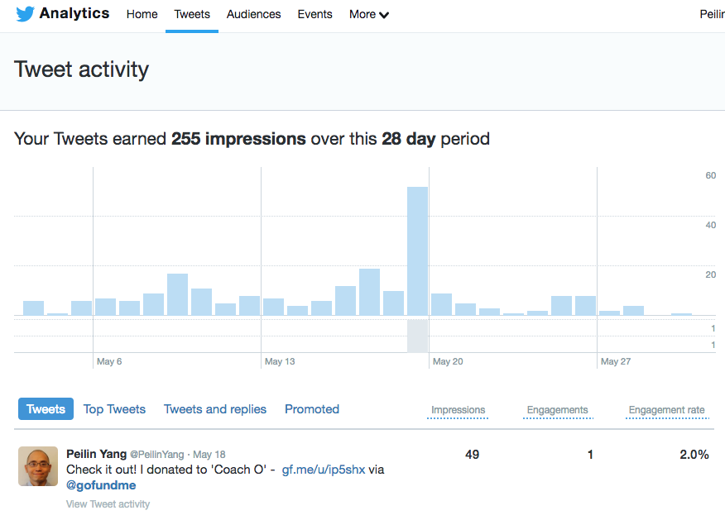
#example – Tweets Engagement
Tweets Engagement shows how many engagements your tweets have received historically and bucketed in hours.
Data is available after 10 seconds the tweet publishes. (real-time)
Data will be validated after 24 hours for accurately charging the ads customers (batch).
Task is Defined as : Processing Twice (Batch + Real-time)

Slide 9
Who We Are
Data Infrastructure Engineering Team
We provide data processing solutions

Slide 10
#BATCH + Real-time (pre-2014)
Pig (batch) + Storm (real-time)
Later on Scalding (batch) + Storm (real-time)
It was hard to maintain two sets of codes at the same time

Slide 11
#SummingBird (2014)
Declarative Streaming Map/Reduce DSL
Real-time platform that runs on Storm
Batch platform that runs on Hadoop
Batch / Real-time Hybrid platform
https://github.com/twitter/summingbird
Oscar Boykin, Sam Ritchie, Ian O'Connell, and Jimmy Lin. Summingbird: A Framework for Integrating Batch and Online MapReduce Computations. Proceedings of the VLDB Endowment, 7(13):1441-1451, 2014.

Slide 12
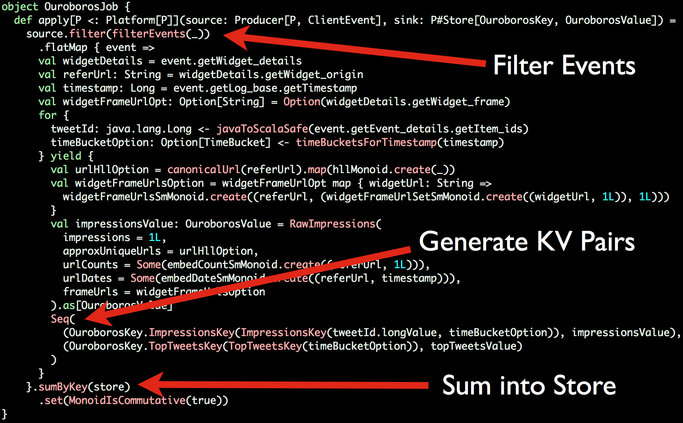
#SummingBird

Slide 13
#SummingBird
It’s about the Monoid (algebraic aggregation)
Still (too) complicated and hard for non-data infras engineers and non-engineers
No backend storage support
No data exploration plan

Slide 14
Real-time Processing
+ Batch Validation + data Exploration
Public Safety
Data Exploration
…
Auditing
…
Validation
Aggregation
…
Storage
Data Analyst
ML/DL Model
Common Tasks
Common Tasks
Applications
Those are missing!

Slide 15
Real-time Processing
+ Batch Validation + data Exploration
Real-time
Heron
Eventbus
Kafka Streams
Beam
…
Persistent Storages
Manhattan
RDBMS
Vertica
HDFS
Batch
Scalding
Spark
GCP Dataflow
…
Query Service
Similar among apps

Slide 16
#Challenges
For other Engineering/Non-Engineering Teams:
Research of the optimal solution for their tasks – batch job runners, streaming techniques, backend storages, data exploration tools, etc.
Stressful maintenance at Twitter’s traffic level
Auditing/Validation/Backfill of the results
For data infrastructure engineering team (us):
We can’t support all the teams for their different needs but with much in common
We’d like to reduce the pain on both sides!

Slide 17
How do we tackle the challenges?
september 2014

Slide 18
#TSAR
TimeSeriesAggregatoR
is Domain Specific Language (DSL)
builds on top of SummingBird
incorporates Backend storage options (more complete end-to-end solution)
comes with Tooling - http/thrift query service, deployment script, easy backfill
is Easy enough for (almost) everyone at Twitter

Slide 19
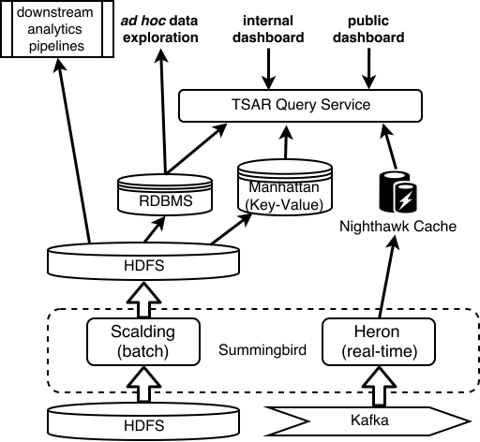
#Architecture

Slide 20
Case Study: Tweets Engagement

Slide 21



A minimal Tsar project
Thrift IDL
Scala Tsar job
Configuration File

Slide 22
#example – Tweets Engagements
Thrift IDL
struct EngagementAttributes {
1: optional i64 client_application_id,
2: optional EngagementType engagement_type,
3: optional i64 user_id
}
Notes:
Talk about the schemas – What is clientId, engagementType and userId; Why do we need them?

Slide 23
#example – Tweets Engagements
aggregate {
onKeys(
(clientApplicationId, engagementType)
)
produce(Count, Unique(userId))
sinkTo(Manhattan, NightHawk)
fromProducer(
Source.map {
(
e.timestamp,
EngagementAttributes(
Some(clientApplicationId),
Some(engagementType),
Some(userId)
)
}
)
}
Scala Tsar job
Dimensions you aggregate on
Metrics
Sinks
Convert events to your schema

Slide 24
#example – Tweets Engagements
Scala Tsar job
aggregate {
onKeys(
(clientApplicationId, engagementType),
(clientApplicationId)
)
produce(Count, Unique(userId), Sum)
sinkTo(Manhattan, NightHawk, Vertica)
fromProducer(
Source.map {
(
e.timestamp,
EngagementAttributes(
Some(clientApplicationId),
Some(engagementType),
Some(userId)
)
}
)
}
Painless Expansion

Slide 25
#example – Tweets Engagements
Configuration File
Config(
base = Base(
namespace = 'tsar-example',
name = ‘tweets-interaction-counter’,
user = 'tsar-shared',
thriftAttributesName = 'TweetAttributes',
origin = ‘2018-05-15 00:00:00 UTC',
jobclass = 'com.twitter.examples.InteractionCounterJob',
outputs = [
Output(sink = Sink.IntermediateThrift, width = 1 * Day),
Output(sink = Sink.Manhattan, width = 1 * Day)
Output(sink = Sink.Vertica, width = 1 * Day)
],
...
Output datastores && Time granularities for aggregation

Slide 26
After Deployment…
• Generate deploy meta-data packaged with your job and logged to Zookeeper
• Compile and bundle your job using pants
• Upload the code to packer
• Auto-generate aurora configuration files
• Deploy a batch job
• Deploy a realtime job
• Deploy a combined http/thrift query service
• Create or update DB tables and views
• Create alerts and viz charts
• Set up anomaly detection

Slide 27
What do USERs NOT Specify?
How to represent the schema in RDBMS / Manhattan
How to represent the aggregated data
How to perform the aggregation
How to locate and connect to underlying services (Hadoop, Heron, Manhattan, …)

Slide 28
Lambda or Kappa?
A combined solution:
Lambda
It has both batch and realtime components
Kappa
The users (other developers at Twitter) write one set of code

Slide 29
What’s behind the scenes?

Slide 30
Design considerations
Answers:
How do we coordinate schemas to keep all physical representations consistent?
Unified schema architecture generated from thrift schema
How do we provide support for flexible schema evolution?
Separation of event production from event aggregation
How do customers easily consume the data?
Automatically generated http/thrift query service

Slide 31
Primitive and Derived Metrics
Primitive Metrics: Metrics that can be added directly together
e.g. Count, Sum
Derived Metrics: The opposite
e.g. Unique, Percentile
Derived Metrics are computed from Primitive Metrics:
e.g. Average = Sum / Count
Users don’t need to specify metrics as primitive or derived

Slide 32
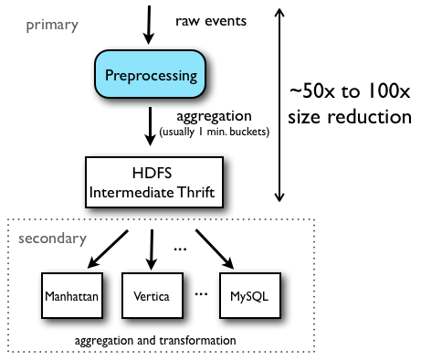
Primary and Secondary Batch Jobs

Slide 33
REal-time Write consistency and Hotkeys
Sometimes Counter only support Long type
What about other monoid types? e.g. Double, List
Tsar solves this by assigning every aggregation key K (at compile time) to a unique node in the corresponding Heron topology. That node then has mastership over K, and it is guaranteed that no other nodes in the topology will update the value of K. (276/280)
What about Hotkeys then?
Pre-Aggregation with events/time intervals

Slide 34
#Takeaways

Slide 35

“Plumbing” works make others’ lives easier

Slide 36
#ThankYou

